Slide 1

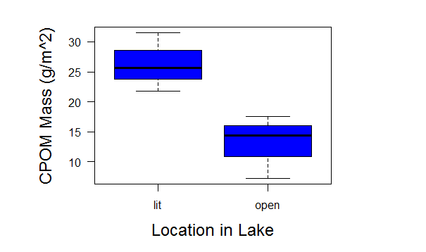
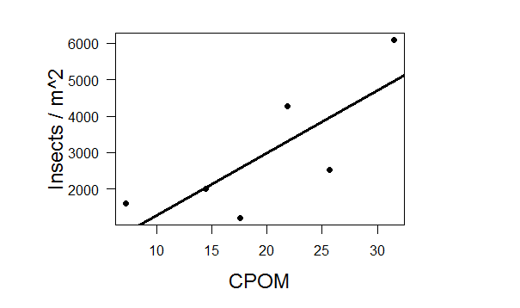
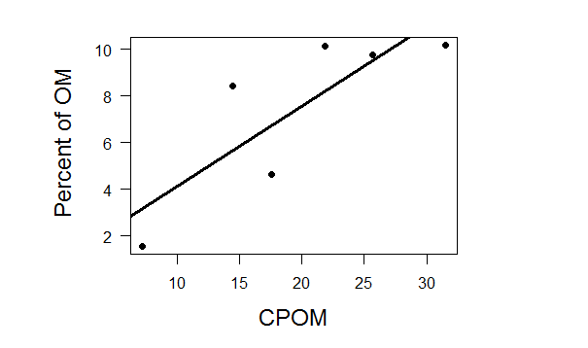
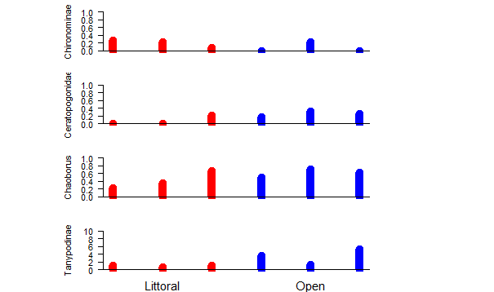
Longwood University
Greater Sediment Organic Matter and Macroinvertabrates Abundance in the Littoral Zone of a Small Pond
Leanna Tacik, Carly Martin, and Dr. Kenneth Fortino; Department of Biological and Environmental Science, Longwood University, 201 High St., Farmville, VA 23909
Introduction
CPOM is greater in littoral zones than open
The greater the CPOM the greater
the insects / m^2
The factors that control carbon cycling are key components in the ways the ecosystem responds to climate change (Navel et al., 2011). There is a gap in the knowledge of carbon cycling as to what role small ponds are taking in the carbon dioxide production and organic material storage (Navel et al., 2011). Small ponds store large amounts of organic carbon within their sediments due to the ability to capture organic material from surrounding watershed (Navel et al., 2011). Carbon that remains in the lake sediments can be subtracted from atmospheric carbon, which can alleviate the effects of climate change; yet organic carbon that is washed into the lake is consumed by sediment microorganisms, the carbon will return to the atmosphere as carbon dioxide (Pond et. al, 2012). Sediment macroinvertebrates have been shown to alter sediment metabolic processes, and therefore may affect organic carbon storage in ponds. The main objective of the study is to evaluate the variation in organic matter and macroinvertabrate communities within a small pond.
Methods
Samples were collected from Wilcke’s Lake, east of the island (open samples) and about 20m from the south shore (littoral samples)
Three replicate samples were collected with an Ekman dredge.
The percent organic matter in the sediment was determined using loss on ignition (LOI) at 550º C.
Samples were washed through a 250μm mesh in the field and preserved in 70% ethanol.
In the lab CPOM was removed from the sample using a 1mm sieve and dried at 50º C.
Macroinvertabrates were removed from the sediments using a dissecting scope, identified and enumerated.
Statistical analysis was performed in R.
The greater the mass of CPOM the greater percent of OM in the sediments
Macroinvertabrates abundance and
identities varies between
littoral and open zones
Conclusion
1) How does the abundance of CPOM affect the species richness of macroinvertebrates?
The littoral area had a greater abundance of CPOM which was correlated with a greater abundance of macroinvertebrates.
Three of the 4 taxa found associated with the CPOM were predators and therefore not using the CPOM as a food source. This suggests that the CPOM may be more important as habitat than as a direct source of energy for the macrobenthos in small ponds.
Acknowledgement
We thank Longwood University’s Cook-Cole Fund and the Department of Biological and Environmental Science for financial support and instrumentation.
(1) Colwell, R. "Biodiversity: Concepts, Patterns and Measurement". The Princeton Guide to Ecology. Princeton: Princeton University Press. pp. 257–263. (2009). (2) Koljonen, S. Quantifying the effects of in-stream habitat structure and discharge on leaf retention: implications for stream restoration no access. Freshwater Science, 31(4), 1121-1130. (2012). (3) Kominoski, J. "Conservation from the bottom up: forecasting effects of global change on dynamics of organic matter and managemen needs for river networks." Freshwater Science. (2012). ( 4) Navel, S. The shredding activity of gammarids facilitates the processing of organic matter by the subterranean amphipod niphargus rhenorhodanensis. Freshwater Biology, 56(3), 481-490. (2011). (5) Pond, G. Biodiversity loss in appalachian headwater streams (kentucky, usa): Plecoptera and trichoptera communities. Hydrobiologia, 679(1), 97-117. (2012).

